Slide 1
CS 103 PROJECT MINI AMAZON
MUHAMMAD ALI MAHMOOD
2021346

Slide 2
Problem statement
Build a mini amazon in which user buys products.Calculate the bill,shipping and tax in the end.

Slide 3
Introduction
In this program we’ve to build an online shopping system.We’ve given the user different categories such as electronics and if the user enters a particular category we output the items in that category.We ask the user if they want to shop more.In the end we calculate the bill,shipping and tax

Slide 4
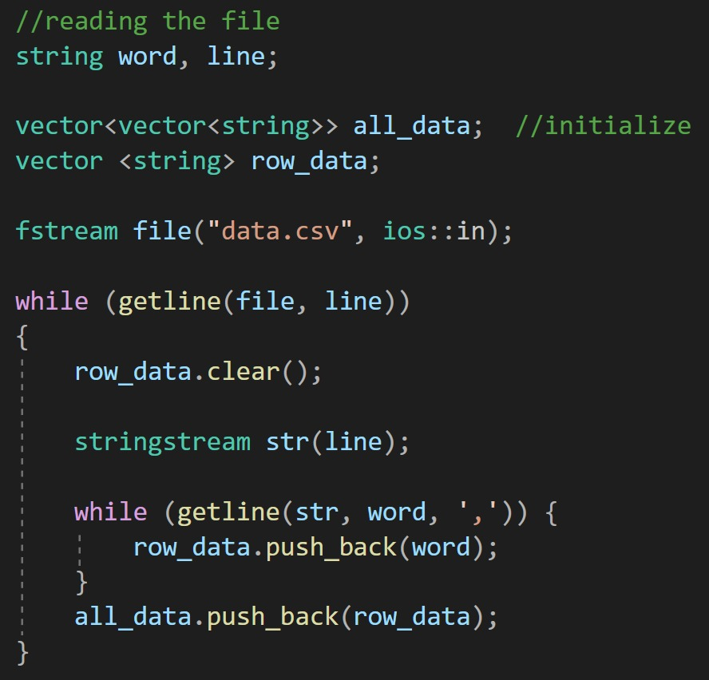
Code description
We have created a csv file with all the categories and items with
price in it.
In this code we are reading from the csv file.
We are saving the data in vector named all_data.
Csv is comma separated values .
We have to separate each box with the help of comma.

Slide 5
We give user a choice to select any of the categories and we display the items of that particular category.
We ask the user what they want to buy and add it to the cart.
We ask the user if they want to continue shopping and if they say yes then all the categories are displayed again.
If the user says no then we calculate the bill,shipping and taxes.
Tax is calculated by 5 percent of the overall bill.
Shipping is calculated by 1 percent of the overall bill.

Slide 6
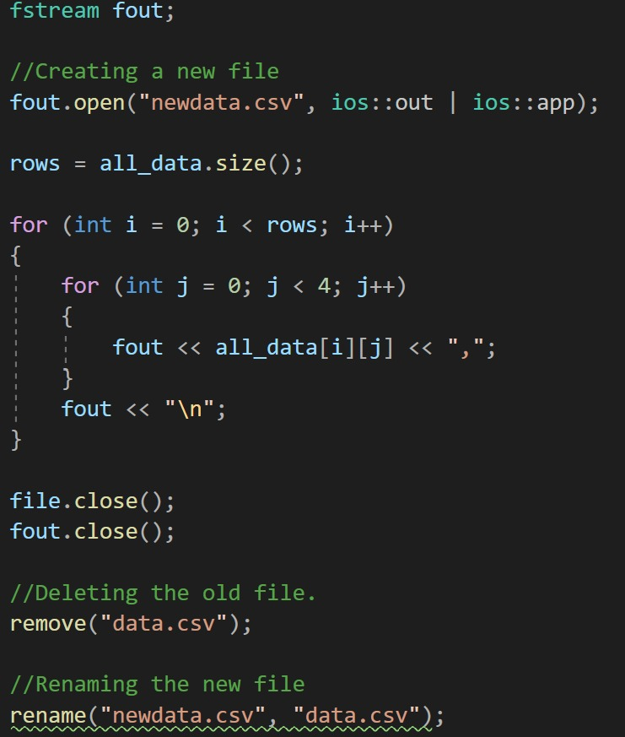
In this code,when a user buys an item we have to update
the file with updated stock so we are creating a new file
named newdata and transferring the new information in
that file and deleting the old file.

Slide 7
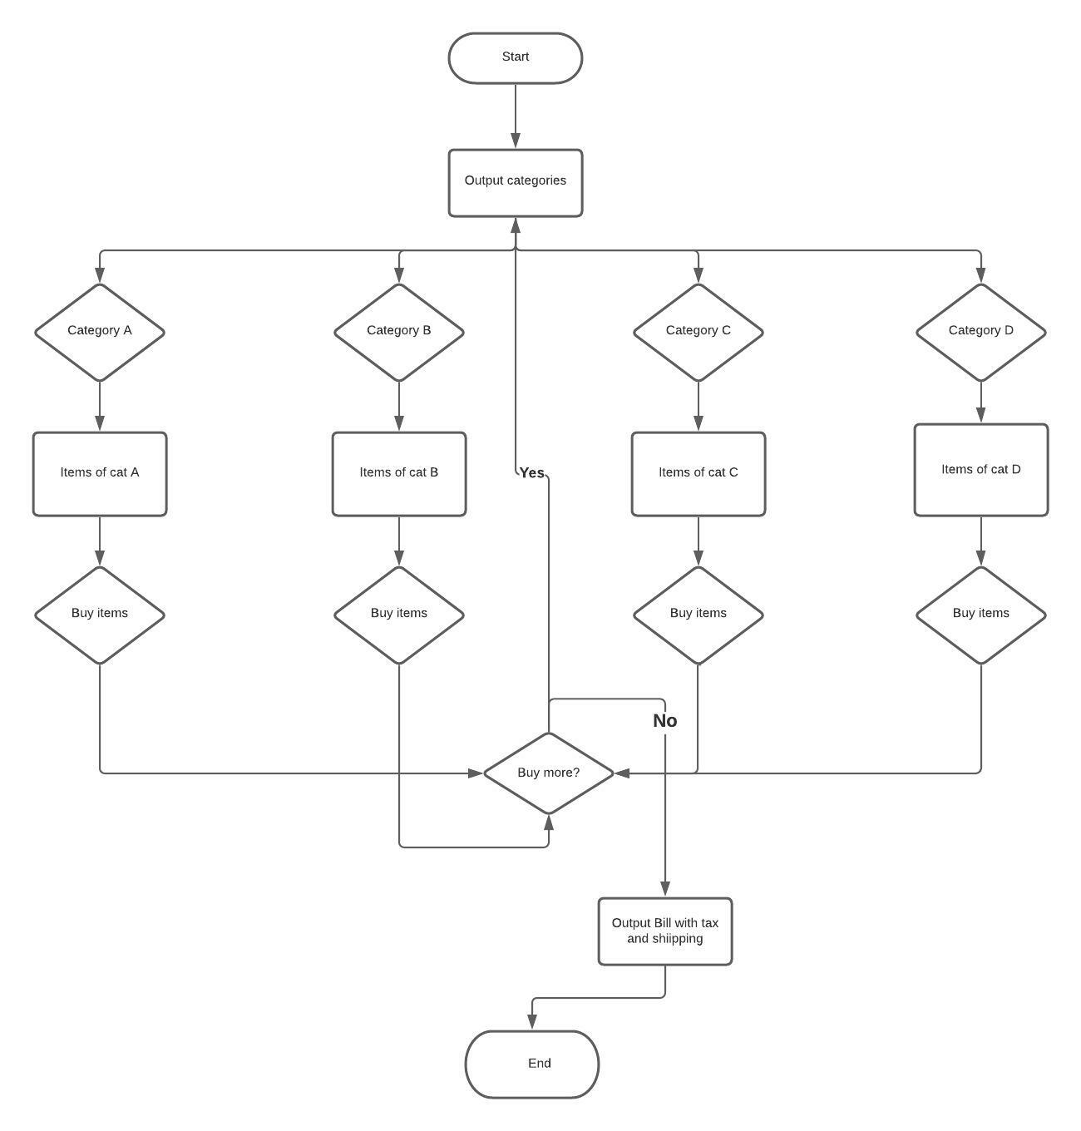

Slide 8
CONCLUSION
Programs like these are very efficient and useful.We should make more projects/programs like these which are useful in our real life.

